Slide 1
The Salvation of the Soul

Slide 2
Salvation of the Soul
1 PETER
Outline

Slide 3
Salvation of the Soul
1 PETER
Preface:
Salvation of the Soul,
Our Hope and Goal
1:3-12

Slide 4
Salvation of the Soul
1 PETER
Preface: Salvation of the Soul, Our Hope and Goal - 1:3-12
The entire preface strikes a not of triumph. A note of encouragement to lift the spirits of the afflicted, to suffering Christians experiencing various trials.

Slide 5
Salvation of the Soul
1 PETER
Preface: Salvation of the Soul, Our Hope and Goal - 1:3-12
Suffering Christians need to know that their present experiences can, by faith, result in a portion in Christ’s suffering and glory, that even attracted the admiration of the prophets and angels.

Slide 6
Salvation of the Soul
1 PETER
Preface: Salvation of the Soul, Our Hope and Goal - 1:3-12
The Nature of Our Salvation - 1:3-5
The Joy of Our Salvation - 1:6-9
The Appeal of Our Salvation - 1:10-12
Notes:
The nature

Slide 7
Salvation of the Soul
1 PETER
The Nature of Our Salvation - 1:3-5
Explains what God has done.
God has given us a hope of a glorious inheritance. This inheritance is our salvation for which is preserved by His Divine power and faithfulness.

Slide 8
Salvation of the Soul
1 PETER
The Nature of Our Salvation - 1:3-5
“As we strive by faith to attain our full birth right – the whole inheritance which can be ours – whatever we have laid up of heavenly treasure is being safely protected for us there” by God’s power and trust. (Hodge, p. 19)

Slide 9
Salvation of the Soul
1 PETER
The Joy of Our Salvation - 1:6-9
Describes Our Salvation and What We Do
We are to exalt in God despite trials we experience, which are purifying our faith for a future glory. The salvation of the soul is the goal of our faith.

Slide 10
Salvation of the Soul
1 PETER
The Appeal of Our Salvation - 1:6-9
Describes What the Prophets Did and What the Angels would Like to Do.
So wonderful is our salvation experience of sharing Messiah’s suffering and glory that the prophets and angels experience the attraction of it.

Slide 11
Salvation of the Soul
1 PETER
The Joy of Our Salvation 1:6-9

Slide 12
Salvation of the Soul
1 PETER
The Joy of Our Salvation - 1:6-9
Peter calls on his readers to rejoice in God despite the trials, which have the purpose of purifying their faith for future glory. This rejoicing is the outward evidence that the salvation of the soul is being effected.

Slide 13
Salvation of the Soul
1 PETER
The Joy of Our Salvation - 1:6-9
“In this you greatly rejoice, though now for a little while, if need be, you have been grieved by various trials,” (1:6)

Slide 14
Salvation of the Soul
1 PETER
The Joy of Our Salvation - 1:6-9
“In this” - “en hoo” – “wherein” [KJV] – looks back to the “…God and Father of our Lord Jesus Christ.”
Ephesian Parallel: “In Him” - “en hoo” (1:7a) points back to “God and Father…” (1:3a)

Slide 15
Salvation of the Soul
1 PETER
The Joy of Our Salvation - 1:6-9
“In Him – “God the Father of our Lord Jesus Christ” you greatly rejoice,…”

Slide 16
Salvation of the Soul
1 PETER
Ephesians Parallels:
Doxology – 1 Pt. 1:3 / Eph. 1:3
Being Chosen – 1 Pt. 1:1-2 / Eph. 1:4-7
Mystery of the Gospel – 1 Pt. 1:12 / Eph. 3:10
Living Stones – 1 Pt. 2:4-7 / Eph. 2:20-22

Slide 17
Salvation of the Soul
1 PETER
Ephesians Parallels:
Mystery of the Gospel – 1 Pt. 1:12 / Eph. 3:10
Instruction to slaves and wives to Submit – 1 Pt. 2:18f / Eph. 5:22f
Jesus as Lord of All – 1 Pt. 3:22 / Eph. 1:20-22

Slide 18
Salvation of the Soul
1 PETER
James Parallels:
Rejoicing in Trials – 1 Pt. 1:6 / James 1:2-3
“My brethren, count it all joy when you fall into various trials, knowing that the testing of your faith produces patience.” (James 1:2-3)

Slide 19
Salvation of the Soul
1 PETER
The Joy of Our Salvation - 1:6-9
“greatly rejoice” “agalliao” - to jump for joy, i.e. exult.
Contrasts
“grieved” “hupethentes” – to be sad, heaviness, grief or sorrow.

Slide 20
Salvation of the Soul
1 PETER
The Joy of Our Salvation - 1:6-9
The sorrow brought on by various trials, is only for “now” (just now) and only “for a little while,”
“little” “oligos” – puny; short.

Slide 21
Salvation of the Soul
1 PETER
The Joy of Our Salvation - 1:6-9
The sorrow brought on by various trials, is “if need be”, - it will come only as necessary and then is good as gone.
“if” “ei” – assumes to be true and
assumes trials are necessary.

Slide 22
Salvation of the Soul
1 PETER
The Joy of Our Salvation - 1:6-9
“various trials” – “poikílois peirasmoís” temptations or tests which we experience, are only for now, and are only for a short time, and come in various ways.

Slide 23
Salvation of the Soul
1 PETER
The Joy of Our Salvation - 1:6-9
“various trials” – “poikílois peirasmoís”
“trials” “peirasmois” – is broader than persecutions “diogmoi” and tribulations “thlipesis”, and can included sickness, accidents, natural disasters, wars, etc. along with tribulations and persecutions.

Slide 24
Salvation of the Soul
1 PETER
The Joy of Our Salvation - 1:6-9
“that the genuineness of your faith, being much more precious than gold that perishes, though it is tested by fire, may be found to praise, honor, and glory at the revelation of Jesus Christ,” (1:7)

Slide 25
Salvation of the Soul
1 PETER
The Joy of Our Salvation - 1:6-9
“genuineness” [NKJV] “dokimion” is a trial or test [KJV] to be found approved.
Not a test to see if we have faith, or to see if we are really saved, but to see the quality, strength or depth of the faith.

Slide 26
Salvation of the Soul
1 PETER
The Joy of Our Salvation - 1:6-9
“your faith” – faith is not a gift of God! Every persons has the ability to exercise his/her own faith in Christ in order to be saved eternally from condemnation, i.e.: Hell. Otherwise how can any be held responsible for something they are not able to do?

Slide 27
Salvation of the Soul
1 PETER
The Joy of Our Salvation - 1:6-9
“your faith” – faith is not a gift of God! Faith itself does not come from God, but “faith comes from hearing and hearing the Word of God” (Romans 10:17)

Slide 28
Salvation of the Soul
1 PETER
The Joy of Our Salvation - 1:6-9
“your faith” – God does not test your faith to see if you have faith, as if God does not know.
You have to have faith to begin with in order it to be tested. One has to have faith in order to continue in the faith.

Slide 29
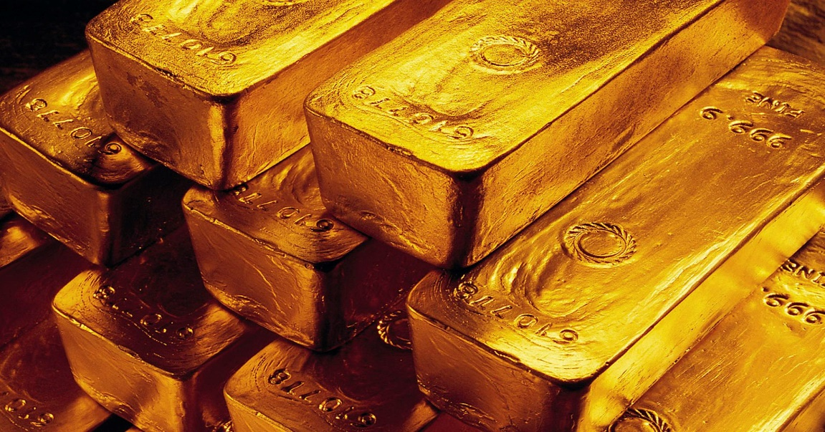
Salvation of the Soul
1 PETER
The Joy of Our Salvation - 1:6-9
“gold that perishes” – God places greater value in your faith than anything in this temporal world.

Slide 30
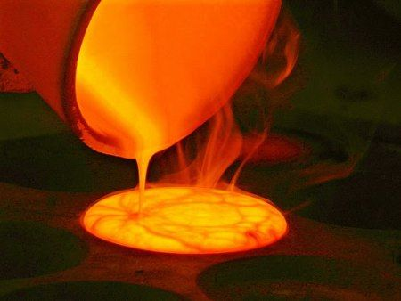
Salvation of the Soul
1 PETER
The Joy of Our Salvation - 1:6-9
“tested by fire” – reflects the purification process of gold that proves its true identity and improves its quality.

Slide 31
Salvation of the Soul
1 PETER
The Joy of Our Salvation - 1:6-9
“Now if anyone builds on this foundation with gold, silver, precious stones, wood, hay, straw, each one's work will become clear; for the Day will declare it, because it will be revealed by fire; and the fire will test each one's work, of what sort it is…”

Slide 32
Salvation of the Soul
1 PETER
The Joy of Our Salvation - 1:6-9
“If anyone's work which he has built on it endures, he will receive a reward. If anyone's work is burned, he will suffer loss; but he himself will be saved, yet so as through fire.” (1 Cor. 3:9-15)

Slide 33
Salvation of the Soul
1 PETER
The Joy of Our Salvation - 1:6-9
“to be found” – suggests the divine search for the pure, true part of our faith which the fires of testing has purified.

Slide 34
Salvation of the Soul
1 PETER
The Joy of Our Salvation - 1:6-9
“to praise, honor, and glory” – After the purification process is complete, God commends and rewards our faith with commendations of praise, reputation and honor, and exaltation and glory. A triune reward from a Triune God.

Slide 35
Salvation of the Soul
1 PETER
The Joy of Our Salvation - 1:6-9
“praise” – is the commendation, “well done, good and faithful servant.” (Mt. 25:21)
“…wait till the Lord comes. He will bring to light what is hidden in darkness and will expose the motives of men's hearts. At that time each will receive his praise from God.” (1 Cor. 4:5) [NIV]

Slide 36
Salvation of the Soul
1 PETER
The Joy of Our Salvation - 1:6-9
“honor” – describes the high distinction or recognition given to the faithful.
“He who overcomes shall be clothed in white garments, and I will not blot out his name from the Book of Life; but I will confess his name before My Father and before His angels.” (Rev. 3:5)

Slide 37
Salvation of the Soul
1 PETER
The Joy of Our Salvation - 1:6-9
“glory” – is the exaltation that God will give to the humble at the coming of Christ.
“When Christ who is our life appears, then you also will appear with Him in glory.” (Col. 3:4)

Slide 38
Salvation of the Soul
1 PETER
The Joy of Our Salvation - 1:6-9
“glory” – is the exaltation that God will give to the humble at the coming of Christ.
“and when the Chief Shepherd appears, you will receive the crown of glory that does not fade away.” (1 Peter 5:4)

Slide 39
Salvation of the Soul
1 PETER
The Joy of Our Salvation - 1:6-9
“glory” – is the exaltation that God will give to the humble at the coming of Christ.
“To him who overcomes I will grant to sit with Me on My throne, as I also overcame and sat down with My Father on His throne.” (Rev. 3:21)

Slide 40
Salvation of the Soul
1 PETER
The Joy of Our Salvation - 1:6-9
“at the revelation of Jesus Christ” – at the “apokalupsis” – the full discloser or uncovering of Jesus Christ.
The “apokalupsis” is not about the end of the world!

Slide 41
Salvation of the Soul
1 PETER
The Joy of Our Salvation - 1:6-9
“at the revelation of Jesus Christ” – at the “apokalupsis” – the full discloser or uncovering of Jesus Christ.
“I make known to you, brethren, that the gospel… it came through the revelation of Jesus Christ.” (Gal. 1:12)

Slide 42
Salvation of the Soul
1 PETER
The Joy of Our Salvation - 1:6-9
“at the revelation of Jesus Christ” – at the “apokalupsis” – the full discloser or uncovering of Jesus Christ.
“He indeed was foreordained before the foundation of the world, but was manifest “phaneroo” in these last times for you.” (1:20)

Slide 43
Salvation of the Soul
1 PETER
The Joy of Our Salvation - 1:6-9
“whom having not seen you love. Though now you do not see Him, yet believing, you rejoice with joy inexpressible and full of glory, receiving the end of your faith -- the salvation of your souls.” (1:8-9)

Slide 44
Salvation of the Soul
1 PETER
The Joy of Our Salvation - 1:6-9
“whom having not seen… Though now you do not see Him,… you rejoice”
The readers were not eyewitness of Jesus ministry or resurrection. And despite not presently seeing Him they still love, believe and rejoice in Him in the midst of trials.

Slide 45
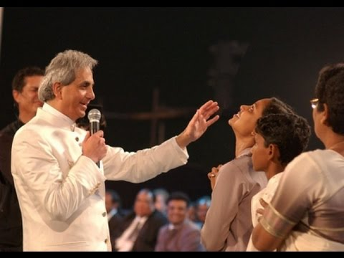
Salvation of the Soul
1 PETER
The Joy of Our Salvation - 1:6-9
Faith centers are all about seeing a miracle from God or hearing a word of knowledge.
They claim to be celebrations of joy?

Slide 46
Salvation of the Soul
1 PETER
The Joy of Our Salvation - 1:6-9
“whom having not seen… Though now you do not see Him ,… you rejoice”
“Jesus said to him, ‘Thomas, because you have seen Me, you have believed. Blessed are those who have not seen and yet have believed.“ (John 20:29)

Slide 47
Salvation of the Soul
1 PETER
The Joy of Our Salvation - 1:6-9
“whom having not seen… Though now you do not see Him… you rejoice”
Peter had seen Jesus, manifested in glory (Matt. 17:1-2) heard Him speak (Matt. 5-7) and handle Him with his hands (1 John 1:1). Even heard the Father speak from heaven (Matt. 3:17).

Slide 48
Salvation of the Soul
1 PETER
The Joy of Our Salvation - 1:6-9
“you rejoice with joy inexpressible and full of glory,” – Though they had not seen or heard anything they rejoiced in Him that could not be totally expressed in words, and full of praise “doxazo” for Him. This happens only when one’s faith is focused on Christ.

Slide 49
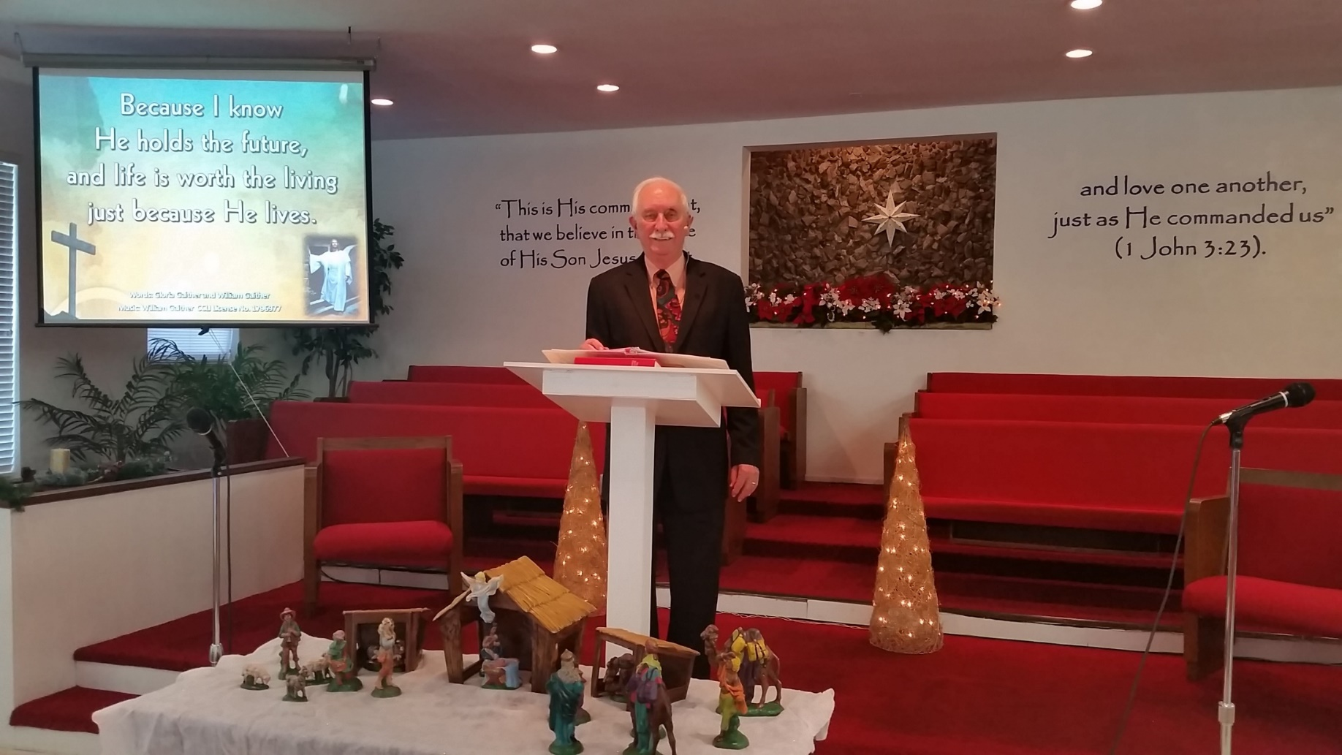
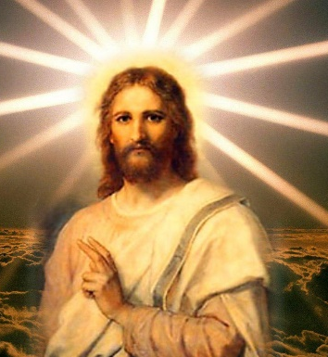
Salvation of the Soul
1 PETER
The Joy of Our Salvation - 1:6-9

Slide 50
Salvation of the Soul
1 PETER
The Joy of Our Salvation - 1:6-9
What does one receive for greatly rejoicing in God whom you have not seen?
The Salvation of the Soul

Slide 51
Salvation of the Soul
1 PETER
The Joy of Our Salvation - 1:6-9
“receiving the end of your faith” is the key to this passage.
“komizomai” is not simply to receive, but to receive back, to get what has belongs to oneself… but kept back, or to get what has come to one’s own by earning” (Hort, p.47)

Slide 52
Salvation of the Soul
1 PETER
The Joy of Our Salvation - 1:6-9
“receiving the end of your faith” is the key to this passage.
Moulton and Milligan support this view, “this verb was especially found in connection with recovering a debt, or getting paid.” Merit implied in the context. (Vocabulary of the Greek T.)

Slide 53
Salvation of the Soul
1 PETER
The Joy of Our Salvation - 1:6-9
Salvation from Judgment
Salvation of the Soul
Salvation from receiving what we deserve – eternal condemnation, i.e.: “Hell” It is contrary to what is our due.
Salvation by receiving what we deserve.
“It is due by virtue of a faith triumphant
in suffering.”

Slide 54
Salvation of the Soul
1 PETER
The Joy of Our Salvation - 1:6-9
“receiving”, in the present tense, is connected in time with the call to rejoice.
The salvation of our souls is presently being actualized. The discloser of it awaits the revelation of Christ is glory.

Slide 55
Salvation of the Soul
1 PETER
The Joy of Our Salvation - 1:6-9
We are in the process of presently “obtaining for ourselves” a rich future with God. Rewards or benefits of a future abundant life for those of us who are found faithful (Revelation 2-3).
The Grace New Testament Commentary, p. 1147

Slide 56
Salvation of the Soul
1 PETER
The Joy of Our Salvation - 1:6-9
“the end of your faith” refers to the “telos” goal or objective.
“The true goal of Christian faith is more that to escape eternal damnation. It is to achieve a fullness of life now, and a brilliant glory in the age to come.” (Z. Hodges, p. 23)

Slide 57
Salvation of the Soul
1 PETER
Suffering Leads to Glory
“Suffering are as necessary to us as they were to our Lord. For Him, the path to glory led to the cross. So also for His followers. It was the great lesson Peter and the other disciples learned (with difficulty) in the period of the Gospels…”

Slide 58
Salvation of the Soul
1 PETER
Suffering Leads to Glory
“This is the great lesson of 1 Peter: as Christ won glory through suffering, so do we through our suffering. If we triumph in it, as He did, we save our souls.” (Zane Hodge, First Peter, p. 23)

Slide 59
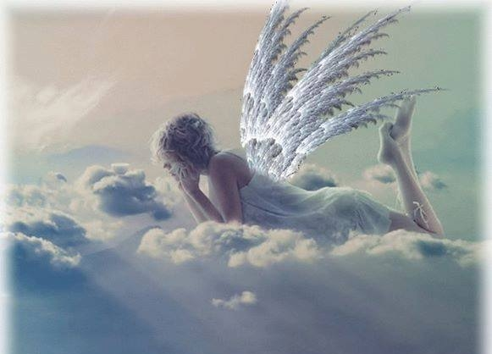
Salvation of the Soul
1 PETER
The Appeal of Our Salvation
1:10-12

Slide 60
Salvation of the Soul
1 PETER
The Appeal of Our Salvation - 1:10-12
“Of this salvation the prophets have inquired and searched carefully, who prophesied of the grace that would come to you,” (1:10)

Slide 61
Salvation of the Soul
1 PETER
The Appeal of Our Salvation - 1:10-12
“this salvation” does not refer to salvation to receive eternal life, for they had already received it in the same way as all Church-age believers do, by believing in Christ for it.

Slide 62
Salvation of the Soul
1 PETER
The Appeal of Our Salvation - 1:10-12
“this salvation” does refer to the salvation of the soul, our share in the sufferings and its outcome in glory.

Slide 63
Salvation of the Soul
1 PETER
The Appeal of Our Salvation - 1:10-12
“the prophets have inquired and searched carefully” – this expresses their effort and desire to understand fully what they predicted to come about.
They prayed to God and studied their own writings and wondered about its significance.

Slide 64
Salvation of the Soul
1 PETER
The Appeal of Our Salvation - 1:10-12
“who prophesied of the grace that would come to you,” – this grace was not for them, but for us, the grace to share in the sufferings of Christ and His glory.

Slide 65
Salvation of the Soul
1 PETER
The Appeal of Our Salvation - 1:10-12
“For to you it has been granted on behalf of Christ, not only to believe in Him, but also to suffer for His sake,” (Phil 1:29).

Slide 66
Salvation of the Soul
1 PETER
The Appeal of Our Salvation - 1:10-12
“searching what, or what manner of time, the Spirit of Christ who was in them was indicating when He testified beforehand the sufferings of Christ and the glories that would follow.” (1:11)

Slide 67
Salvation of the Soul
1 PETER
The Appeal of Our Salvation - 1:10-12
The prophets were not questioning the meaning of their prophecies. They understood they spoke of the suffering and glories to follow. It was the details “what” and the timing “what manner of time” in which they wondered.

Slide 68
Salvation of the Soul
1 PETER
The Appeal of Our Salvation - 1:10-12
“To them it was revealed that, not to themselves, but to us they were ministering the things which now have been reported to you through those who have preached the gospel to you by the Holy Spirit sent from heaven -- things which angels desire to look into.” (1:12)

Slide 69
Salvation of the Soul
1 PETER
The Appeal of Our Salvation - 1:10-12
The prophets did not understand everything they were writing, but what they did understand is that what they wrote was for a later generation to benefit, it was “not to themselves”.

Slide 70
Salvation of the Soul
1 PETER
The Appeal of Our Salvation - 1:10-12
The prophets were forward-looking, “to them it was revealed”. The readers were backward-looking, “which now have been reported to you through those who have preached the gospel to you”.

Slide 71
Salvation of the Soul
1 PETER
The Appeal of Our Salvation - 1:10-12
“those who have preached the gospel to you” – And those who had preached the good news to them and to us by the Holy Spirit reported the very details about which the prophets wondered.

Slide 72
Salvation of the Soul
1 PETER
The Appeal of Our Salvation - 1:10-12
“things which angels desire to look into”
“look into” - means “to bend over” (to see) something (Luke 24:12; John 20:5; 11) It suggest the intense interest of angels in our experience of the Messianic Salvation.

Slide 73
Salvation of the Soul
1 PETER
The Appeal of Our Salvation - 1:10-12
The prophets longed to be part of the Messianic Experience. They enquired about the time and were told that such participation was not for them, but for those of a future day. Our special privilege is that we actually life in the fulfillment of what the prophets foretold.

Slide 74
Salvation of the Soul
1 PETER
Conclusion

Slide 75
Salvation of the Soul
1 PETER
The entire preface 1:3-12 strikes a note of triumph. No other approach could better lift the spirits of the afflicted than this. That the suffering Christian (follower of Christ) is to realize his experience can, by faith accomplish the salvation of the soul, which is nothing less than a portion in the Messiah’s suffering and glory.

Slide 76
Salvation of the Soul
1 PETER
Our goal, the end of our faith, is the salvation of the soul which is the total transforming work of God upon our lives, which is presently being realized in the midst of Christ like suffering, and which in the future will be unveiled in Christ like glory.

